Slide 1


FACEMASK
SE-2017
Ulyqpanova aruzhan

Slide 2


The purpose of my project :
Define face
Create facetracker
Apply mask

Slide 3
09.11
https://www.youtube.com/watch?v=4jYYHaTwWvY&t=1942s- The basic information
https://www.youtube.com/watch?v=8mK5aY5YOCc
Learn to html programming language.

Slide 4
10.11
Learn to JavaScript programming language
6 hour video completely about JavaScript: https://www.youtube.com/watch?v=Bluxbh9CaQ0&t=4701s

Slide 5

11.11 I started reading about the library p5.js and I learned about the setup, draw and preload functions. Via the official library page: https://p5js.org/learn/

Slide 6
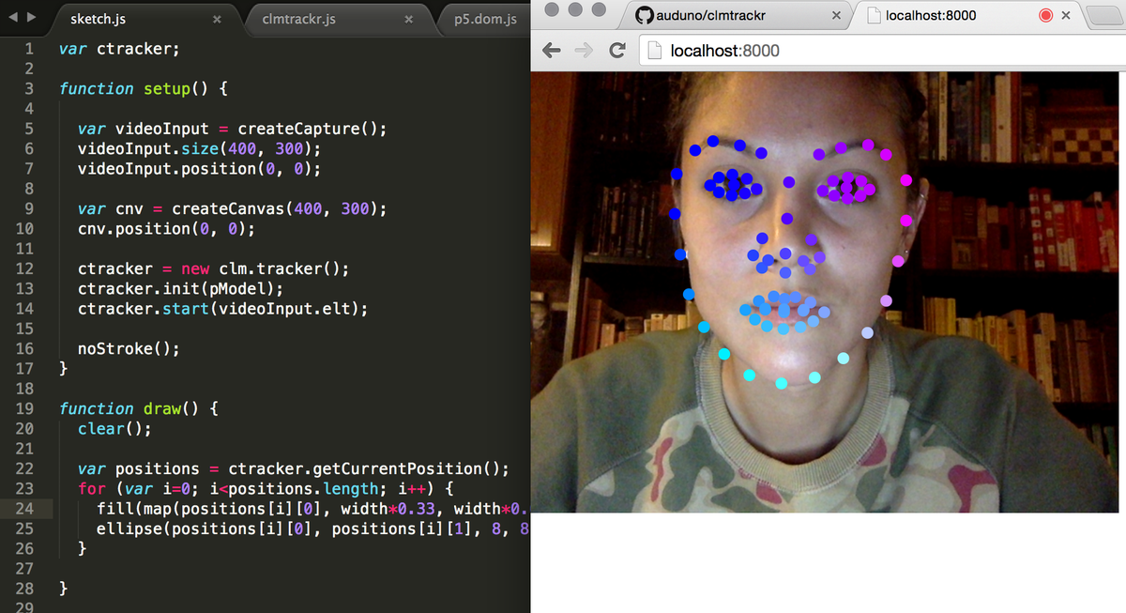
12.11
I watched video tutorials on how to identify a face using the library clmtrackr:
https://www.youtube.com/watch?v=kCHpFe4T7_A&t=444s
https://www.youtube.com/watch?v=Agpnp1G7zTM

Slide 7
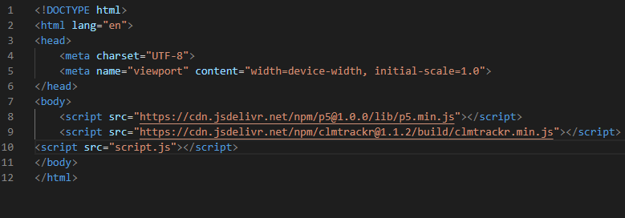
13.11
I started writing the first part of the code:

Slide 8
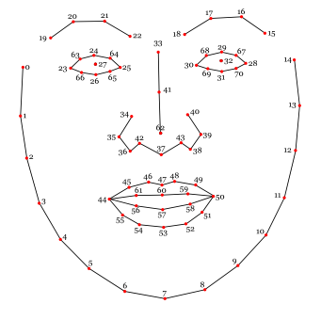
16.11 - until today
I write and test my js code

Slide 9
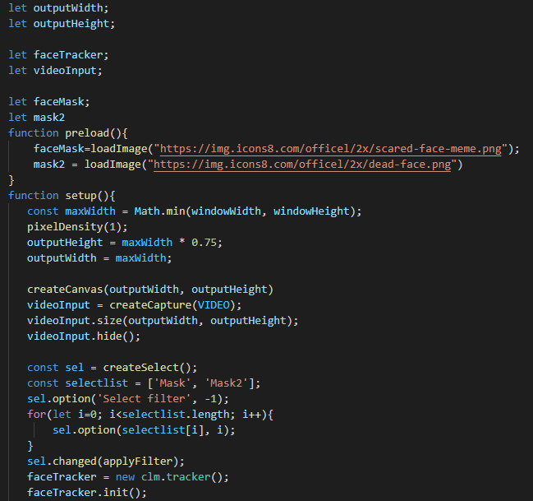
My JavaScript code:

Slide 10
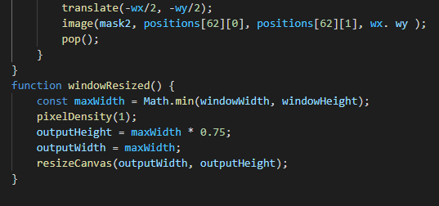
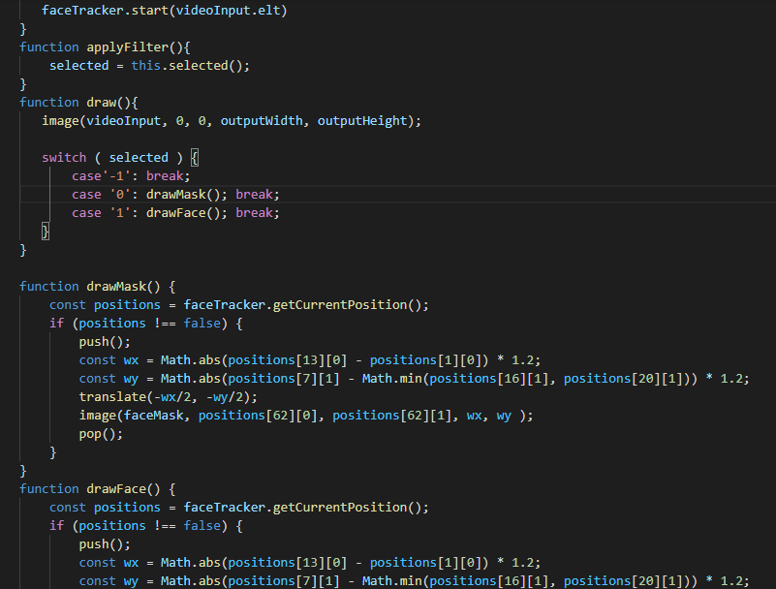

Slide 11
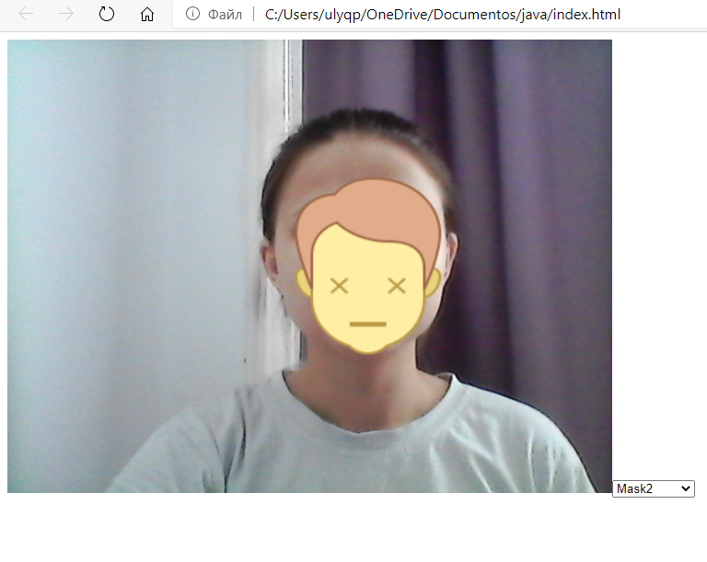
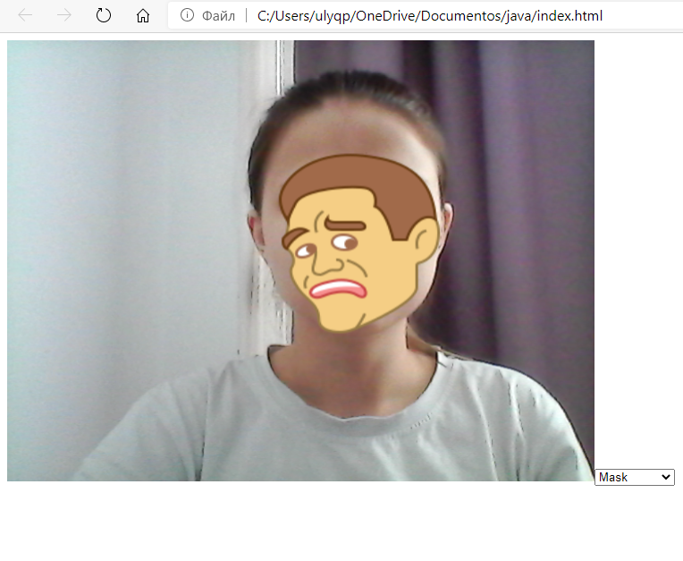
How work my code:

